Slide 1
CS3205 – HCI in Software Development Understanding Users and their Tasks
Dr. Mark Floryan
Rice Hall 203
mrf8t@cs.virginia.edu

Slide 2
The Bottom Line
Need to know:
1. Who are your users (and what are they like)?
2. What do they need to do in the system (i.e., what are their tasks and goals)?
How?
There are some common techniques for doing so…and a few common pitfalls. Let’s discuss this process in detail!!

Slide 3
A Process
1. Identify Users (+ other stakeholders if necessary)
2. Identify and Prioritize User Needs/Tasks
This is typically called Needfinding
3. Establish High Level Usability Goals that link Users to the Tasks they wish to complete.
4. Formalize Usability Goals as Usability Requirements!

Slide 4
1. Identify Users
Who will be using the system?
Age
Gender
Cultural background
Technological experience / expertise
Be careful NOT to stereotype too much
E.g., old people can’t use computers…
We want to focus on user details that:
Are going to affect the way we design our interface!
Are significant edge cases
Highlight important differences between users that we need to design around

Slide 5
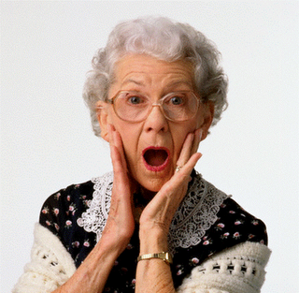
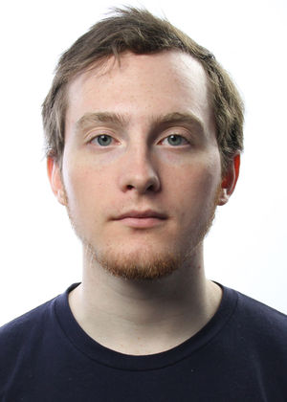
Identify Users: Contrived Example
AARP Website:
Starcraft:

Slide 6
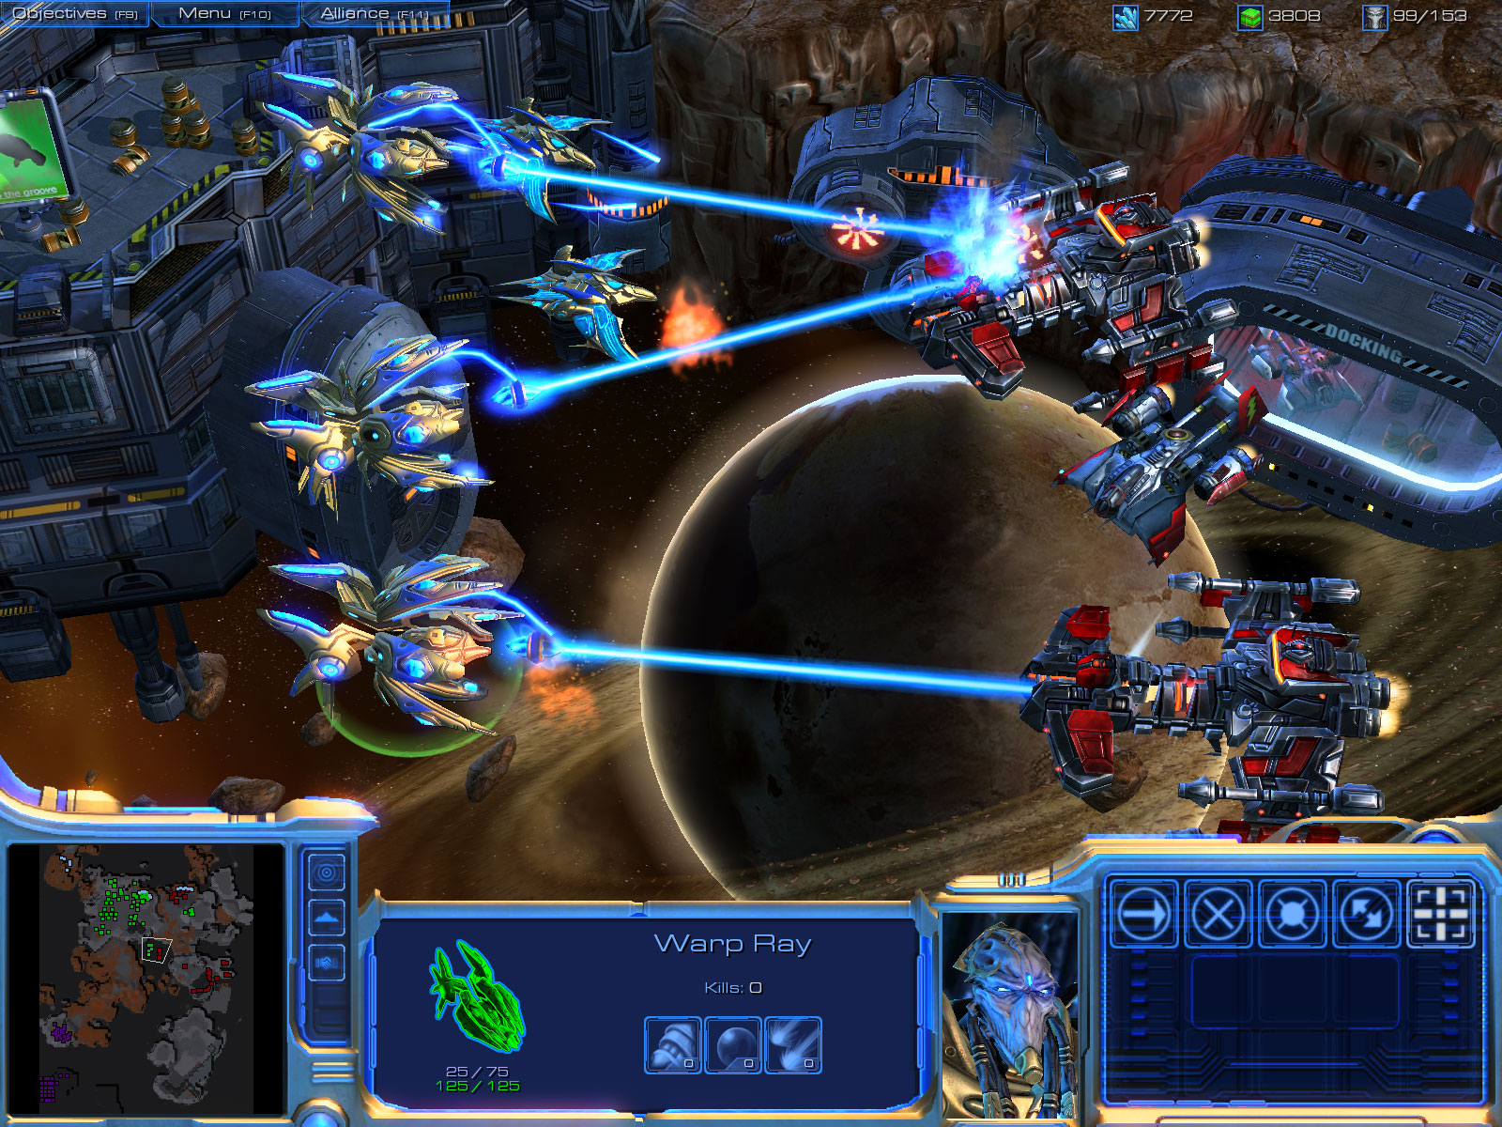
Common Pitfall: Overgeneralizing Users
Is the user base just a bunch of 15 – 30 year old gamers?

Slide 7
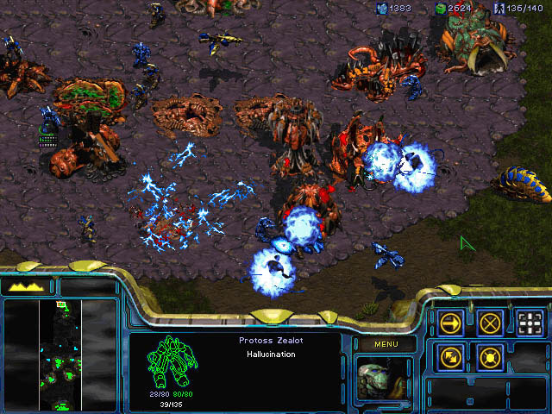
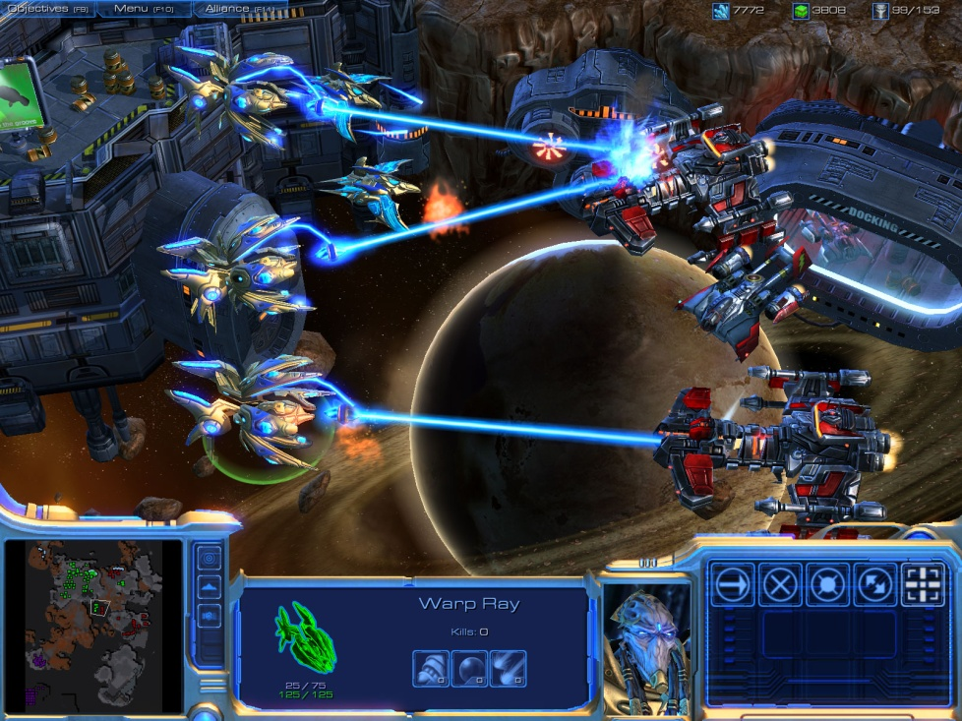
Oh! It is more complicated than that…
1998
2010

Slide 8
1. Identify Users: Some Common Things
Frequency of use is a common user characteristic we need to capture. What if we have a mixture of these??
Novice: step-by-step, clear information
Expert: flexibility, access/power
Frequent Short cuts, customizability
Infrequent: clear instructions, e.g. menu paths

Slide 9
Overview of User Analysis Techniques
Educational Guess
Small Scale Discussions
Compare to Similar
Data Driven
e.g., I’m redesigning SIS, so students. I know something about students so I’ll just write about what I know.
e.g., Chat with a handful of students about their background, age, etc. Try to extrapolate from small sample.
e.g., Compare to the known user base of a similar system that you think will have a similar clientele.
e.g., Find and / or collect current demographic info on College students. Manually perform a census for data you want but do not have access to.
Cheaper, less robust
Expensive, time-consuming, robust

Slide 10

Example: YELP!
Who are your users?
Could just guess…but…
Users probably are similar to other social media sites.
So let’s go find some facebook (or other similar product) user data to get a sense for it.
Of course, you have to account for constraints as well, which means you will probably get a subset of the facebook user base.

Slide 11
User Distributions: Be as precise as you can
Actual user bases are distributions.
Example:
80% of users are expected to be male 18-25
10% expected to be female 18-25
10% expected to be 25-40
Etc.
When possible, requirements should define this expected distribution as well as user persona information for each group of the chosen taxonomy.

Slide 12
Common Problem: User Roles
Many systems have multiple user roles!
Example: SIS has instructor role versus student role.
User requirements are very different for each
Must define both!
Various roles will often have different user distributions, must describe each!!!
Start by identifying the various user roles for your system.

Slide 13
Common Technique: User Persona
It is common to Prepare at least one user persona for each user role
From Alan Cooper’s book, The Inmates Are Running the Asylum
I suggest preparing at least three for each role, but one might suffice.
A description of a archetypical, hypothetical, imaginary user
Description should focus on the behaviors and goals related to the specific domain of a product
What is this person’s end goals for using the product?

Slide 14
Persona Example
Patricia is an English professor who has written several books of poetry. She has been using computers for word-processing since 1980, although the only two programs she’s used are Nota Bene and Microsoft Word. She doesn’t want to spend time learning details of how a computer works, and tends to store all her files in whatever directory they’d go in if you didn’t know about directories. (From Spolsky.)

Slide 15
How Personas Can Be Useful
User personas are essentially a mental exercise in understanding your user base on a more micro level.
Often reveals aspects of users that you were not already thinking of. May reveals new paths of explorations.
Intended to complement, not replace, a broad range of qualitative and quantitative user analysis techniques.
You probably think this is silly, but studies show it helps identify important user characteristics that will spill over into a better design.
See https://dl.acm.org/citation.cfm?id=997089

Slide 16
How Personas Can Be Useful
Descriptions should help identify
workflow and behavior patterns
goals
environment
attitudes
From multiple user points of view!
Can help in
conceptual models
defining usability requirements
prioritizing (or cutting) features
evaluating alternatives
Will make engineers more user-focused

Slide 17

Example: Wal-Mart
Quick exercise:
Write a short user persona for a Walmart customer.

Slide 18
Example: Wal-Mart
In 2009, Walmart asked customers:
“Do you want our stores to be less cluttered?”
Invariably, people said ‘yes’
Why?

Slide 19
Example: Wal-Mart
What happened?
Profit decreased…a lot! $1.85 billion
Why? Because decluttering costs a lot of money, but users didn’t actually care!
i.e., it did NOT lead customers to come to the store more often or buy more goods.

Slide 20
Example: Wal-Mart
Lesson:
Understanding users is about what they DO, what they actually care about, not necessarily what they SAY they care about.
These can be very different things, so you need to be careful when you analyze your users.

Slide 21
2. Identify and Prioritize User Tasks
Now that we have a user base, let’s:
List the TASKS those users will need to be able to perform in our system.
Prioritize this list.

Slide 22
Overview of Task Analysis Techniques
Educational Guess
Small Scale Discussions
Formal Resources
Ethnography
Hmmm…seems like these users would want to do task x, y, and z.
e.g., Chat with a handful of users about what common tasks they try to solve.
e.g., A company has a set of policies of work for their employees. That document outlines the tasks.
Shadow a person for a day / week / month and watch them perform their work. Take notes, make observations, have follow-up discussions.
Cheaper, less robust
Expensive, time-consuming, robust

Slide 23
Needfinding techniques
Questionnaires:
A series of questions designed to elicit specific information
Questions may require different kinds of answers: simple YES/NO; choice of pre-supplied answers; comment
Often used in conjunction with other techniques
Can give quantitative or qualitative data
Good for answering specific questions from a large, dispersed group of people

Slide 24
Needfinding techniques
Interviews:
Forum for talking to people
Structured, unstructured or semi-structured
Props, e.g. prototypes, can be used in interviews
Good for exploring issues
But are time consuming and may be infeasible

Slide 25
Needfinding techniques
Workshops or focus groups:
Group interviews
Good at gaining a consensus view and/or highlighting areas of conflict

Slide 26
Needfinding techniques
Naturalistic observation / Ethnography:
Spend time with stakeholders in their day-to-day tasks, observing work as it happens
Gain insights into stakeholders’ tasks
Good for understanding the nature and context of the tasks
But, it requires time and commitment from a member of the design team, and it can result in a huge amount of data

Slide 27
Needfinding techniques
Studying documentation:
Procedures and rules are often written down in manuals
Good source of data about the steps involved in an activity, and any regulations governing a task
Not to be used in isolation
Good for understanding legislation, and getting background information
No stakeholder time, which is a limiting factor on the other techniques

Slide 28
Let’s take a break:
And look at some fun design fails:

Slide 29
Let’s take a break:

Slide 30
Let’s take a break:

Slide 31
Let’s take a break:

Slide 32
Let’s take a break:

Slide 33
Let’s take a break:

Slide 34
Let’s take a break:

Slide 35
3. Establish High Level Usability Goals that link Users to the Tasks they wish to complete.
Usability Goal: An abstract (often high-level) criteria by which a system must pass to be considered ‘usable’.
Usability Requirement: A falsifiable, well-defined requirement for assessing a usability goal.
* Some consider usability goals and requirements to be the same. I think they are subtly different.

Slide 36
Examples: Usability Goals
Functional:
“Users are able to identify the purpose of the login button without help.”
“Users can login quickly and efficiently.”
“Users are aware of the download whole album function.”
“Users can comfortably reach all buttons on the control pad.”
Affect:
“Users do not become frustrated.”
“Users remain attentive.”

Slide 37
4. Formalize Usability Requirements
Once you have usability goals, convert these into falsifiable (or as near falsifiable as possible) usability requirements.
Remember that requirements should be provable via experimentation, unlike usability goals which are more high level.

Slide 38
Falsifiability
From Wikipedia:
the trait of a statement, hypothesis, or theory whereby it could be shown to be false if some conceivable observation were true.
i.e., a statement is falsifiable iff you can design an experiment that can render the statement false easily.
This is the gold standard for usability requirements, not always achievable.

Slide 39
Simple Example: Falsifiability
1. The world contains at least 1 million white swans
It is hard to prove that this is false. How do you prove that there are not 1 million white swans?
2. All swans are white.
VERY falsifiable because a single observation of a non-white swan renders the hypothesis false.

Slide 40
Usability Requirements: Examples
“Instructor will be able to locate, access, and view the waitlist for a given course within 5 seconds”
Note the specific time requirement makes this hypothesis falsifiable.
Is this really a reasonable requirement?
What if every system you build (assuming you build multiple potential interfaces) all fail to meet this requirement?
What if the requirement is not achievable?

Slide 41
Usability Requirements: Examples
“Instructor will be able to locate, access, and view the waitlist for a given course within 5 seconds”
A couple rules of thumb:
You want your requirements to be as testable as possible, but also reasonable and meaningful (e.g., having 30 minutes in the requirement above is just as bad).
If possible, find a similar system or interface and measure similar tasks. Then, try to design something that outperforms the current solutions.
If this isn’t feasible, you may need to make a basic prototype first and use experimentation to settle on a reasonable value.

Slide 42
Usability Requirements: Examples
“>=90% of users will report, on a 1-5 Likert scale, that the system was enjoyable to use by rating the system as a 4 or 5.”
Note that saying “All users will report…” is more falsifiable, but probably not as reasonable to expect from any system.

Slide 43
A Process
1. Identify Users (+ Stakeholders if necessary)
2. Identify and Prioritize User Tasks
Gather data from users if necessary.
3. Establish Usability Goals that link Users to the Tasks they wish to complete.
4. Formalize Usability Goals as Usability Requirements!

Slide 44
Note!
The usual Software Engineering principles apply to this process.
Generally, this is a highly iterative process and is NOT linear.
It is almost ALWAYS more helpful to gather information from users and stakeholders directly.
Intermediate prototypes (we will talk about prototyping in more detail later) should be shown to users and stakeholders when possible.

